Slide 1
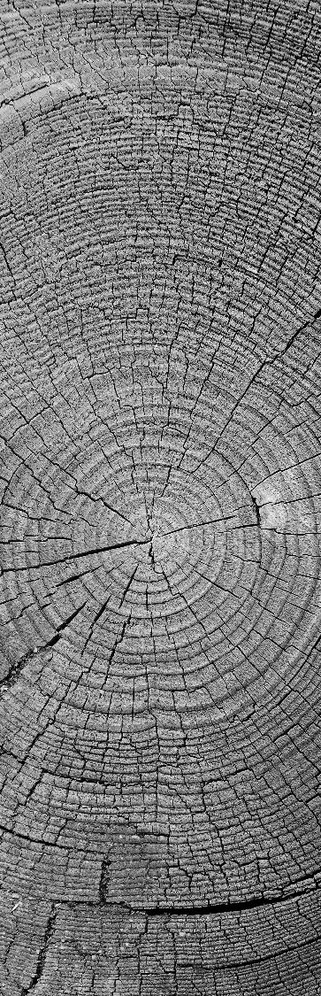
Gridding and Optimization for a Drone Swarm
The National Institute of Engineering Mysore
Adithya Sanjeev B
Prathvi Rao
Sanjana Raj

Slide 2
Introduction
The Big Picture

Slide 3
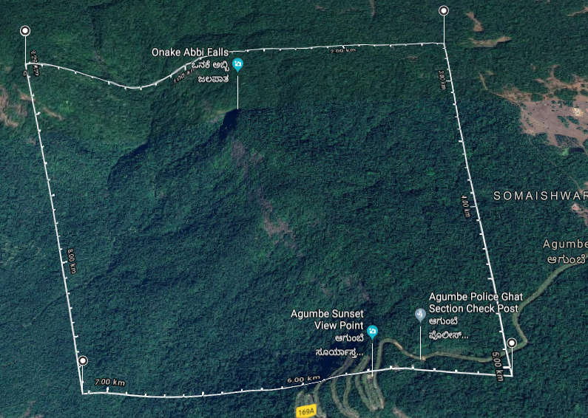


The aim of the integrated project
Goal is to complete a mission by navigating autonomously and share vital information.
The main purpose of the these drone is to scout the disaster areas or inaccessible terrain areas and report with the relevant data to the Cloud Data Centre for any analytics and processing.

Slide 4
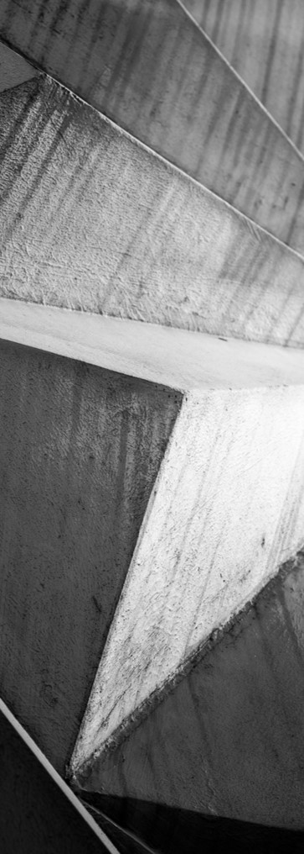
Literature Survey
Sources for our research.
KML: https://developers.google.com/kml/documentation/kmlreference
QGIS: https://qgis.org/en/docs/index.html
Polygon Splitting Algorithm: http://www.khetarpal.org/polygon-splitting/
PyQGIS Developer Cookbook: https://docs.qgis.org/testing/en/docs/pyqgis_developer_cookbook/
M´arton G´otzy, D´aniel Het´enyi, L´aszl´o Bl´azovics, “Aerial Surveillance System with Cognitive Swarm Drones”, 28th International Conference 2016 Cybernetics and Informatics (K&I), Levoca, Slovakia

Slide 5

Gridding
Problem Statement and Formulation

Slide 6
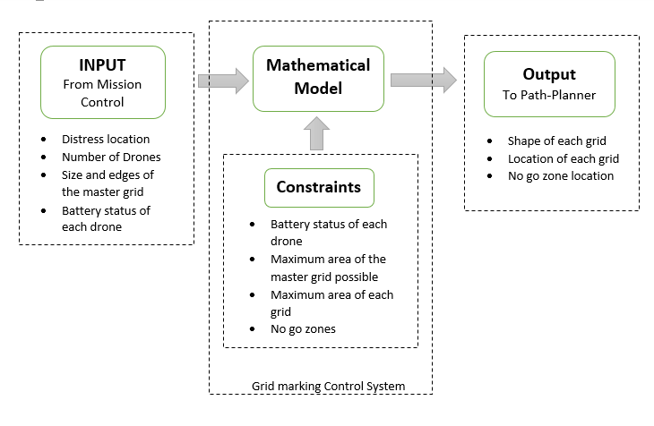
Block diagram

Slide 7
Tool survey
KML (Keyhole Mark-up Language): KML is used to pinpoint the location, add image overlay etc. Similar to XML. Have basic non predefined tags like points, co-ordinates etc.
QGIS: Geographic Information System is designed to capture, store geographical data. QGIS is a framework used on top of GIS. This includes an inbuilt map which gives the values like the type of terrain, altitude etc. data at a given location. This can be included in python script and can depict the mathematical modelled values easily on to the map. This also consists of static map and gridding capabilities
Python Libraries:
PyKML
FastKML
Geographic Library
SimpleKML

Slide 8
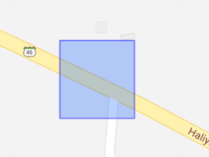
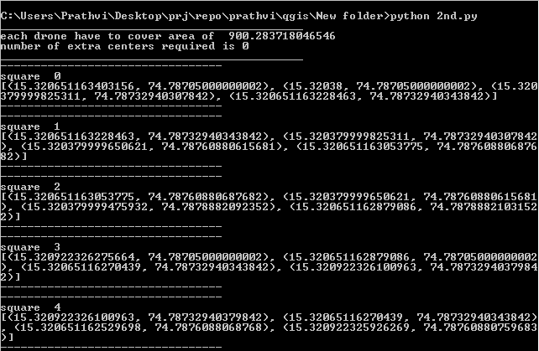
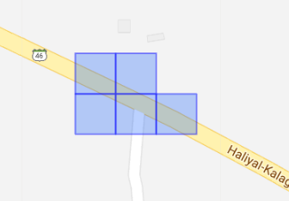
Area division algorithm
Area Division
Result and Iterations

Slide 9
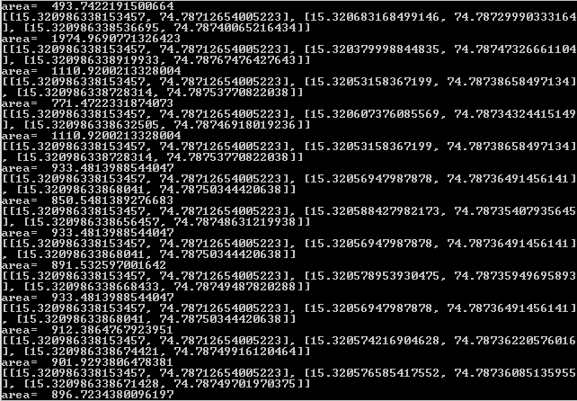
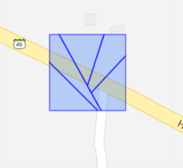
line division algorithm
Line Division
Result and Iterations

Slide 10
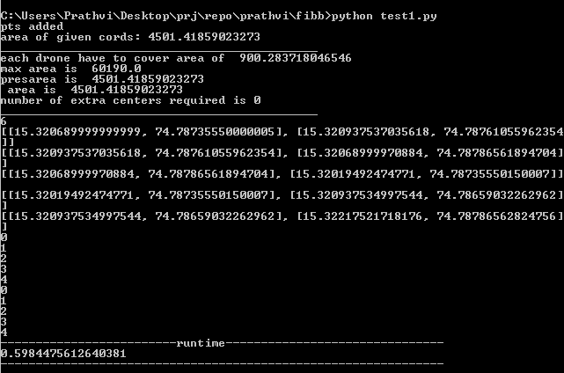
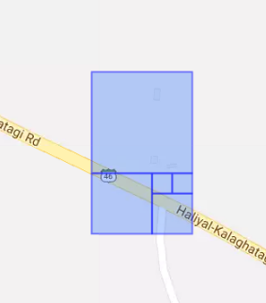
Spiral algorithm
Spiral
Result and Iterations

Slide 11
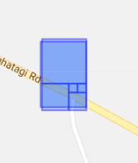
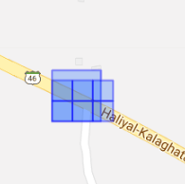
comparison
Operation Time
Loss of Area
Number of drones | Time in seconds
Area Division Algorithm
5 | 1.000037193
10 | 1.251970291
15 | 1.375807762
Line Division Algorithm
5 | 1.391474009
10 | 1.883895636
15 | 2.509415388
Spiral Algorithm
5 | 0.83661437
10 | 0.922720432
15 | 1.088864565

Slide 12
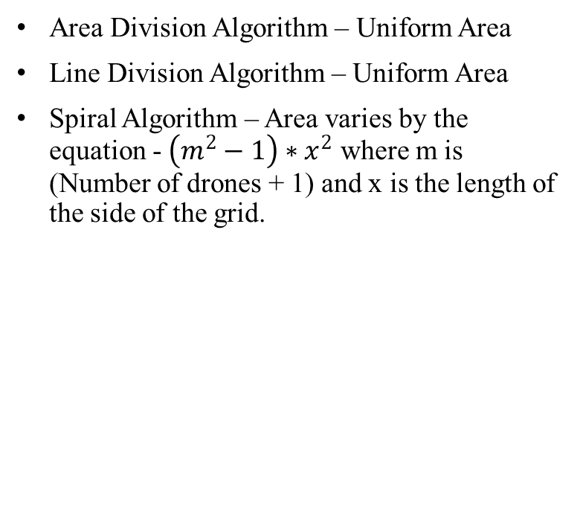
comparison
Variation of area allocated
Shape of grids possible
Area Division Algorithm – Uniform Area
Line Division Algorithm – Uniform Area
Spiral Algorithm – Area varies by the equation - $\left(m^{2}−1\right)∗x^{2}$ where m is (Number of drones + 1) and x is the length of the side of the grid.
Area Division Algorithm – Square
Line Division Algorithm – Any Polygon
Spiral Algorithm – Square

Slide 13
comparison
Advantages
Disadvantages
Area Division Algorithm
Fast and simple to calculate.
Line Division Algorithm
Polygons can be of any shape.
Efficient calculation with no loss of area and blind spots.
It considers only required number of drones.
Spiral Algorithm
Operation time is faster when compared to other two algorithms.
Priority can be assigned to area where probability of disaster is higher
Area Division Algorithm
Polygons are restricted to squares.
Areas in the corner of the master grid are lost, creating blind spots.
Considers all the drones available not taking the efficient number.
Line Division Algorithm
The algorithm consumes more iterations making it slower and more complex.
Spiral Algorithm
Polygons are restricted to squares.
Area of the squares must be in the Fibonacci series which implies that the master grid has to be able to accommodate Fibonacci squares.

Slide 14
Applications
Robotic vacuum cleaners – Roombas
Archaeological surveys
Choppers used in rescue missions
Service robots for indoor applications
To place multiple sensors appropriately at a particular place in order to monitor different parameters
To allocate BTS transmission towers in cellular areas

Slide 15
Future scope
This project can be improvised in the future by using a better and efficient value of the efficiency coefficient by taking some more parameters and constraints into consideration and taking real values by testing it in real world scenarios.
It can also be enhanced to perform real-time gridding task directly by the drones, by recognizing the new constructions and obstacles and learning about it in a built-in neural net of the system so that it can mark that spot as an obstacle to avoid.
It can also learn about disaster-prone areas and can prioritize that region to check for any calamities.

Slide 16
THANK YOU
WOODGROVE BANK

